Slide 1
Zurich
Double Lock-In
Lee Jong Geon

Slide 2
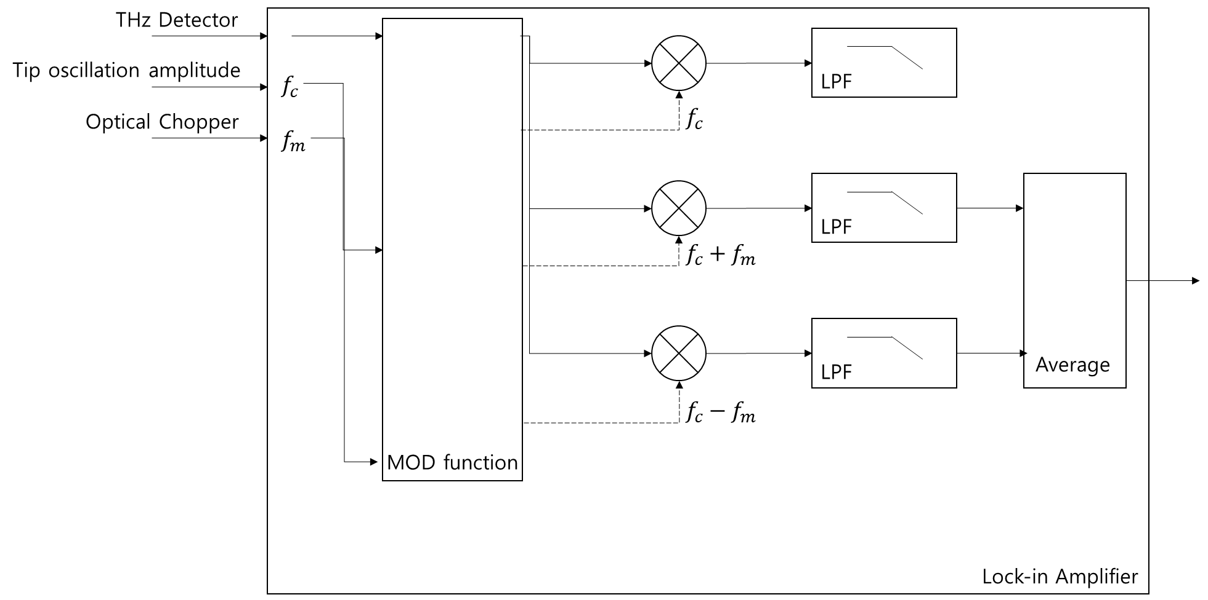
Double Lock-in

Slide 3
Double Lock-in
Front Panel
THz Detector
(from pre-amp)
Input 1
Input 2
Output 1
Output 2
Tip oscillation amplitude
(from EasyPLL)
Back Panel
Aux 1 (<20kHz)
Optical
Chopper

Slide 4
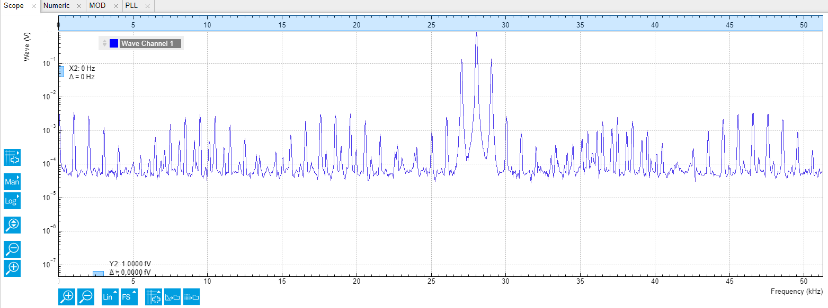
Double Lock-in
Function generator: AM, 28kHz, 1kHz
Output1: 28kHz → Input 2, Output2: 1kHz → AUX In 1

Slide 5
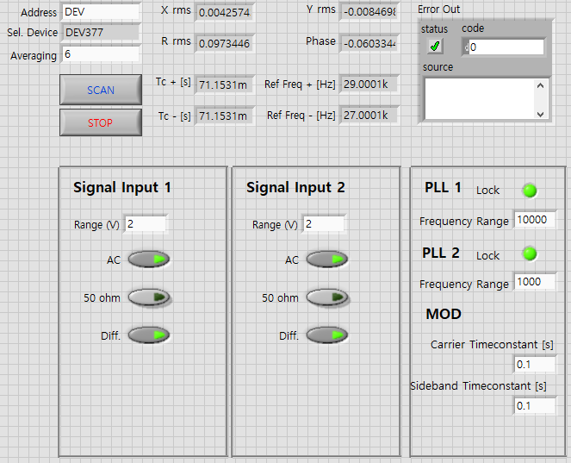
Double Lock-in

